Slide 1
AFOB : Applied Microbiology (AM)
Our mission
Development of microorganisms for various applications including industrial, medical and environmental ones to solve problems in modern society
Our research interests
Screening or developments of microorganisms for industrial biotechnology to. Produce chemicals, materials and biofuels
Screening or developments of microorganisms for medicals production
Screening or developments of microorganisms for treating environmental pollutions

Slide 2
Our members
The AM division of AFOB proudly represents a strong Asian network of prominent researchers in the field of industrial, medical and environmental microorganisms. We pursue to recruit scientists from the Asian countries that do not have a AM member.
Our board
Prof. George Guo-Qiang Chen is serving as a chair of the AM board. The AM division welcomes new members who are interested in building an intimate international network of the Asian bioengineers.
Chair | Guo-Qiang Chen | chengq@mail.tsinghua.edu.cn | Tsinghua University | Mainland China
Vice chair | Yuan Kun Lee | yuan_kun_lee@nuhs.edu.sg | National University of Singapore | Singapore
Member | Khanom Simarani | hanom_ss@um.edu.my | Universiti Malaya | Malaysia
Member | Jyoti Maharjan | jyotimaharjan@yahoo.com | Nepal Academy of Science and Technology (NAST) | Nepal
Member | D. Tumenjargal |  | National University of Mongolia | Mongolia
Member | Chien-Yan Hsieh | mch@nknu.edu.tw | National Kaohsiung Normal University | Taiwan (China)
Member | Rujikan Nasanit | rujikan@su.ac.th | Silpakorn University | Thailand
Member | Adisak Romsang | adisak@cri.or.th | Mahidol University | Thailand
Member | Yanhe Ma | ma_yh@tib.cas.cn | Institute of Microbiology, Chinese Academy of Sciences | Mainland China
Member | Mitsuyoshi Ueda |  | Kyoto University | Japan
Member | Heenam Stanley Kim | hstanleykim @korea.ac.kr | Korea University | Korea
Member | Md. Mozammel Hoq | mhoq@du.ac.bd | Department of Microbiology, University of Dhaka | Bangladesh
Member | Ashok Dubey | akdubey@nsut.ac.in | NSUT | india

Slide 3
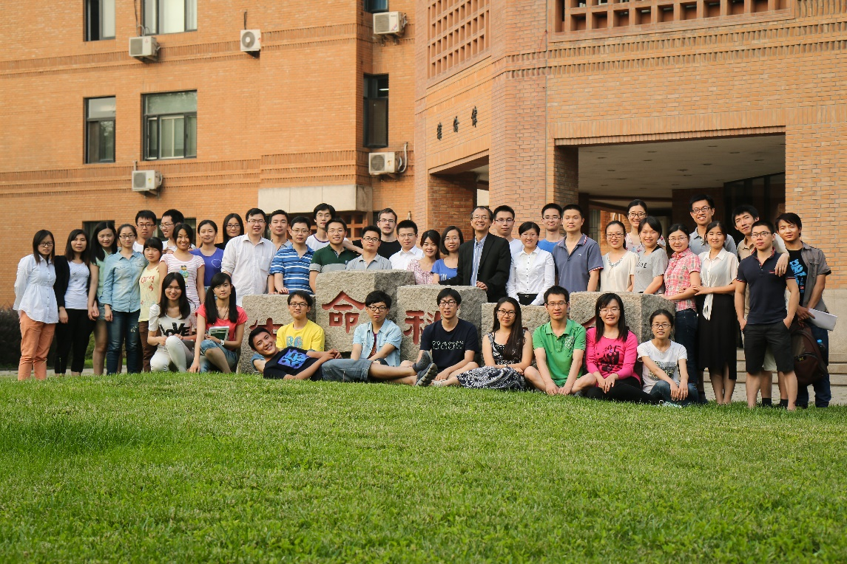
Our gallery （to be completed)

