Slide 1
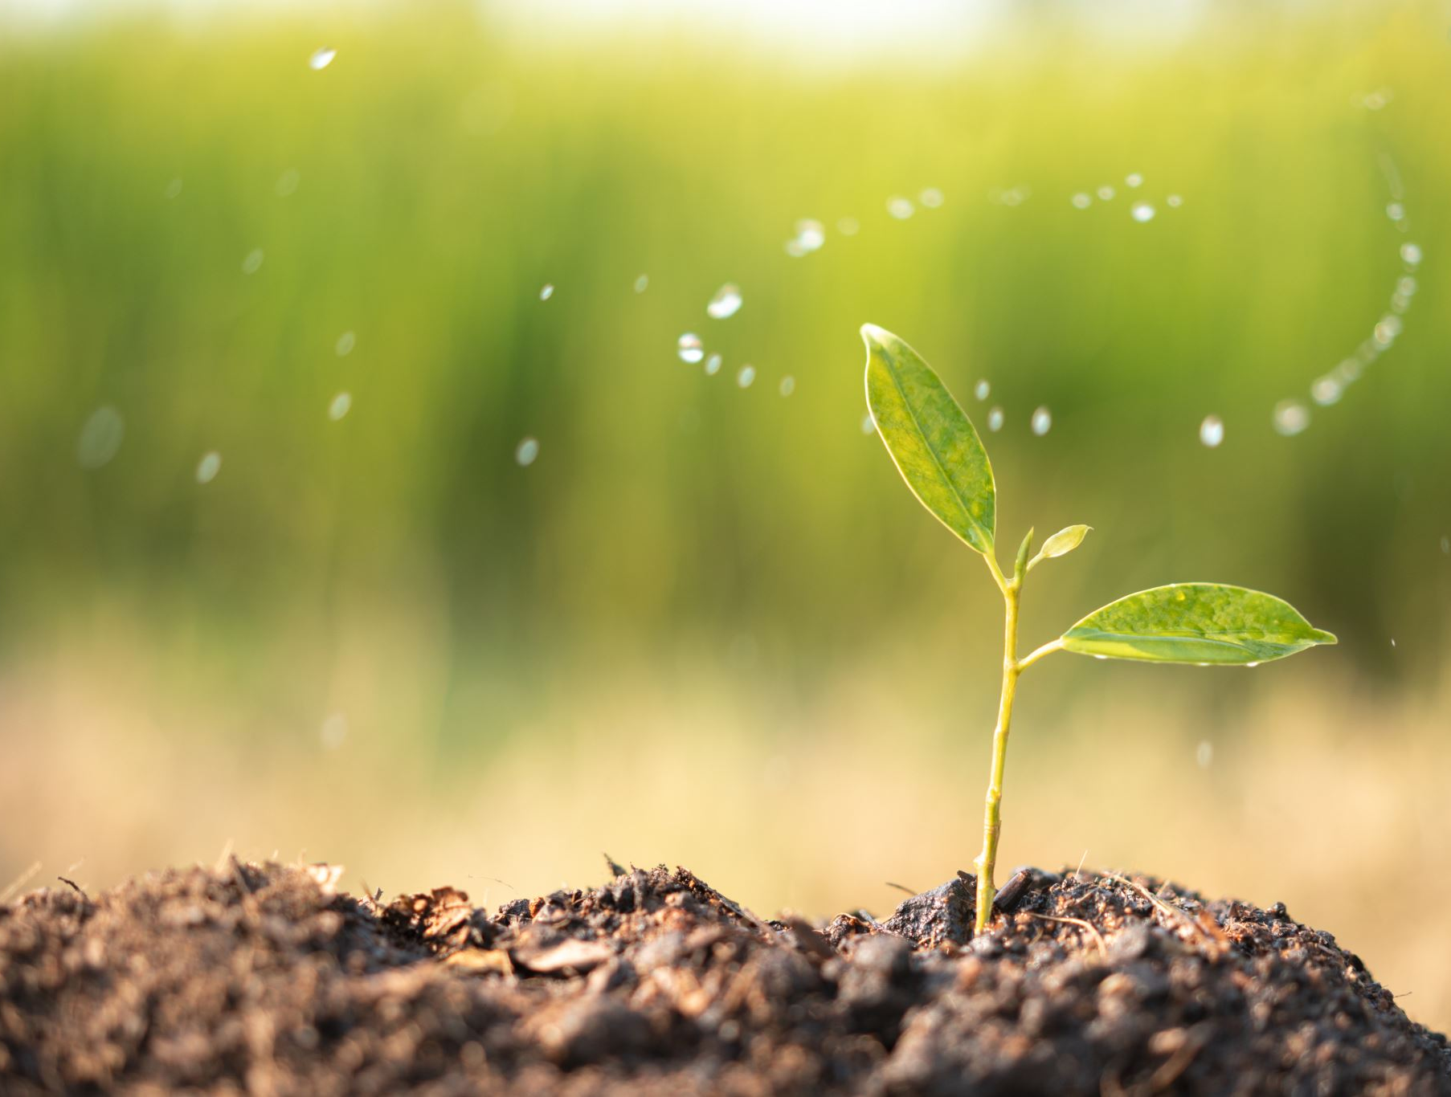
ENVIRONMENTAL BIOTECHNOLOGY DIVISION (AFOB-EB)

Slide 2
AFOB-EB MISSION
AFOB Environmental Biotechnology Division (AFOB-EB) aims to establish an active collaboration and networking for scientists, researchers and industrial practitioners who are working in the fields of bioremediation, biomass conversion technology, biorefinery, low carbon, zero-emission and environmental-friendly technology.

Slide 3
AFOB-EB RESEARCH INTERESTS
Bioremediation
Bio-based and green materials
Environmental friendly and green manufacturing technologies
Zero-emission technology
Cascade utilization of bio-based resources
Biomonitoring
Pollution prevention through biological methods
Waste management and treatment

Slide 4
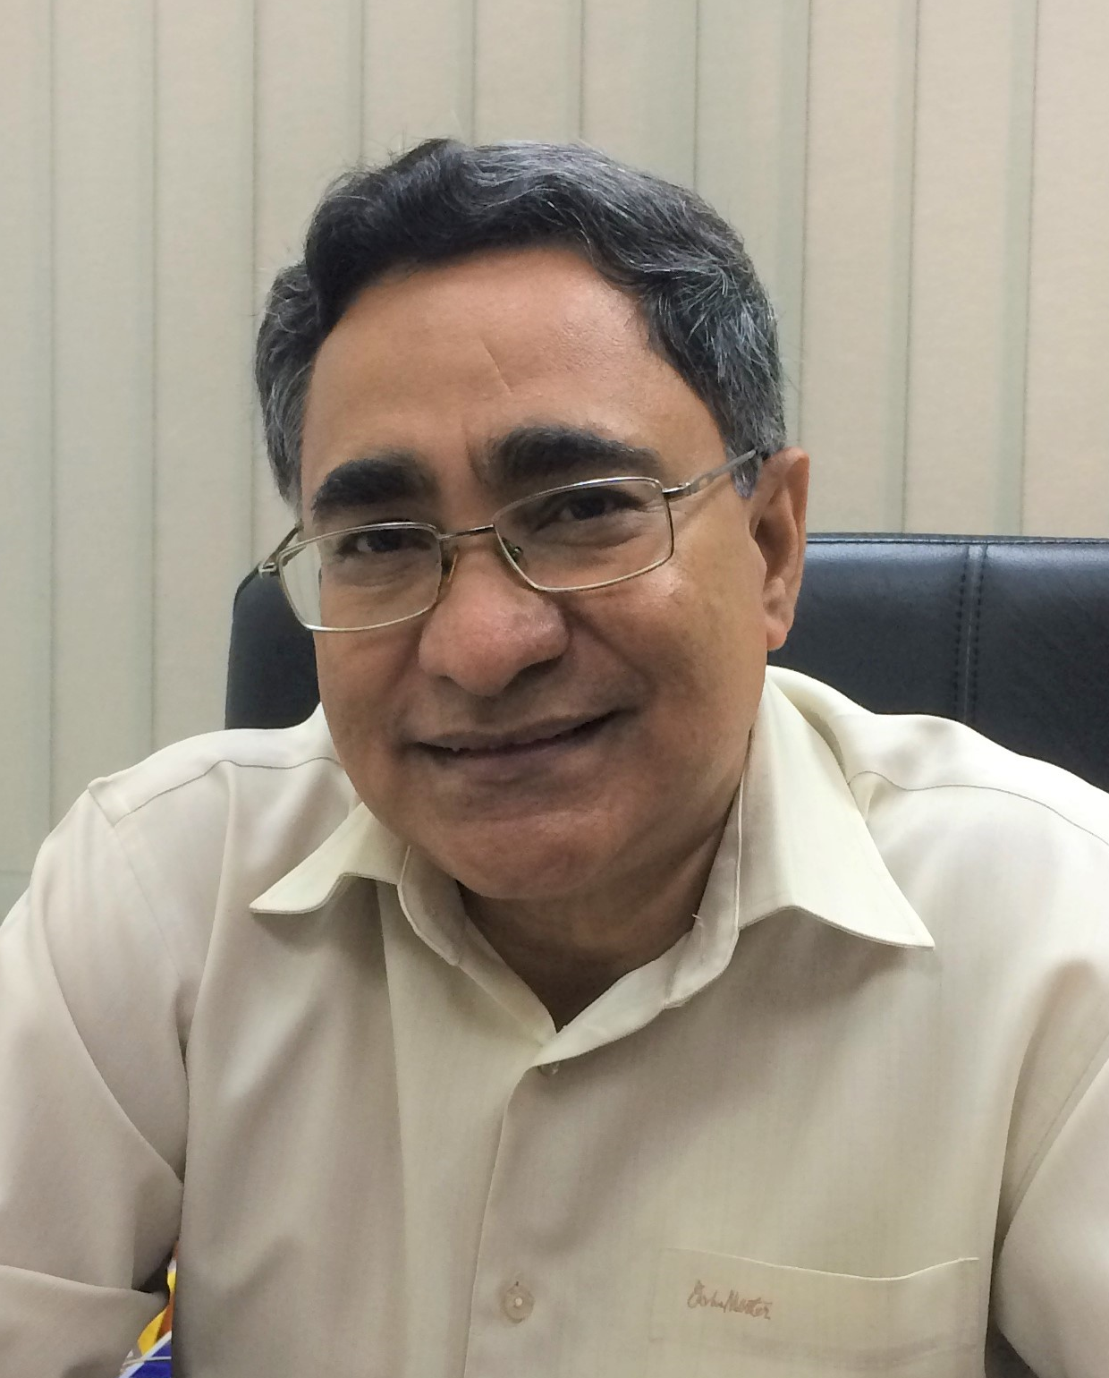
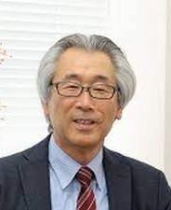
DIVISION CHAIR
BOARD MEMBER
Ginro Endo, Tohoku Gakuin University, JAPAN
Nyam-Osor Batkhuu, National University of Mongolia, MONGOLIA
Alissara Reungsang, Khon Kaen University, THAILAND
Sureewan Sittijunda, Mahidol University, THAILAND
Jong Moon Park, POSTECH, SOUTH KOREA
Analiza P. Rollon, University of the Philippines Diliman, PHILIPPINES
Arun Goyal, IIT Guwahati, INDIA
Chien-Yen Chen, National Chung Cheng University, TAIWAN
Shen-Long Tsai, National Taiwan University of Science and Technology, TAIWAN
To Kim Anh, Hanoi University of Science and Technology, VIETNAM
Yong Yang-Chun, Jiangsu University, CHINA
Xiaojun Zhang, Shanghai Jiao Tong University, CHINA
Mohd Ali Hassan
Universiti Putra Malaysia ,
MALAYSIA
alihas@upm.edu.my
Masao Fukuda
Nagaoka University of Technology,
JAPAN
masao@vos.nagaokaut.ac.jp
AFOB-EB DIVISION SECRETARY
Hidayah Ariffin,
Universiti Putra Malaysia, MALAYSIA
hidayah@upm.edu.my

Slide 5
AFOB-EB MEMBERS RESEARCH EXPERTISE
No. | Name | Institution | Country | Research Expertise | Email
1. | Prof. Dr Mohd Ali Hassan | Universiti Putra Malaysia | MALAYSIA | Biomass Utilization Technology, Biocompost, Biochar, Wastewater Treatment Technology | alihas@upm.edu.my
2. | Prof. Dr Masao Fukuda | Nagaoka University of Technology | JAPAN | Microbial degradation of hazardous chemicals | masao@vos.nagaokaut.ac.jp
3. | Prof. Dr Alissara Reungsang | Khon Kaen University | THAILAND | Bioenergy, Bioremediation of pesticides, Bioplastics (PHA) | alissara@kku.ac.th
4. | Prof. Dr Tsai Shen-Long | National Taiwan University of Science and Technology | TAIWAN | Green Energy (biofuel, biofuel cells, biocatalysts), Molecular Biotechnology, Reactor Design | stsai@mail.ntust.edu.tw
5. | Prof. Dr Yong Yang-Chun | Jiangsu University | CHINA | Electron based biorefinery (microbial fuel cell, electrochemical active biofilm), Intelligent microbiology, Biosensors | ycyong@ujs.edu.cn
6. | Prof. Dr Chien-Yen Chen | National Chung Cheng University | TAIWAN | Microbial fuel cells, Biomimicry and biomineralization, Biological synthesis of nanoparticles for environmental science, Geomicrobiology and geotechnology, Microbial-induced carbonate precipitation for the sediment reinforcement, Biosurfactant production & applications, Foam fractionation | chien-yen.chen@oriel.oxon.org

Slide 6
AFOB-EB MEMBERS RESEARCH EXPERTISE
8. | Prof. Dr Xiaojun Zhang | Shanghai Jiao Tong University | CHINA | Microbial ecology of complex communities in wastewater and soil environment | xjzhang68@sjtu.edu.cn
9. | Prof. Dr Hongzhi Tang | Shanghai Jiao Tong University | CHINA | Applied and environmental microbiology, microbial food technology, biodegradation and bioconversion. | tanghongzhi@sjtu.edu.cn
10. | Prof. Dr Hidayah Ariffin | Universiti Putra Malaysia | MALAYSIA | Biopolymers, Nanocellulose, Biomaterials, Biomass Utilization Technology, Biocomposites | hidayah@upm.edu.my
11. | Dr To Kim Anh | Hanoi University of Science and Technology | VIETNAM | Biodegradation, Lignocellulose | anh.tokim@hust.edu.vn
12. | Prof. Dr Ginro Endo | Tohoku Gakuin University | JAPAN | Environmental Science, Applied Microbiology, Mercury contamination | Gendo@mail.tohoku-gakuin.ac.jp
13. | Prof. Dr Hwai-Shen Liu | National Taiwan University | TAIWAN | Bioremediation, Bioprocess Intensification | hsliu@ntu.edu.tw

Slide 7
AFOB-EB MEMBERS RESEARCH EXPERTISE
14. | Dr Sureewan Sittijunda | Mahidol University | THAILAND | Biohydrogen, biogas, bioplastic, waste utilization | sureewan.sit@mahidol.ac.th sureewan.sit@mahidol.ed sittijunda27@gmail.com
15. | Prof. Dr Arun Goyal | IIT Guwahati | INDIA | Molecular Biology, Protein Engineering, Rational Enzyme Engineering, 3-Dimensional Structure (In silico, crystal and solution) and Function analysis of enzymes and their industrial (Biorefinery, therapeutic, food, Pulp and paper) applications. | arungoyl@iitg.ac.in
16. | Nyam-Osor Batkhuu | National University of Mongolia | MONGOLIA | Biodiversity, Forest ecology, Forest conservation | bnyamosor@yahoo.com batkhuu@num.edu.mn
17. | Jong Moon Park | POSTECH | SOUTH KOREA | Biohydrogen production Metabolic Engineering of Plant Secondary Metabolism Environmental remediation engineering | jmpark@postech.ac.kr
18. | Xin-Hui Xing | Tsinghua University | CHINA | Metabolic engineering, Bioconversion | xhxing@tsinghua.edu.cn
19. | Analiza P. Rollon | University of the Philippines Diliman | PHILIPPINES | Wastewater treatment, anaerobic digestion | analiza.rollon@up.edu.ph aprollon@up.edu.ph

