Slide 1
AFOB : NanoBiotechnology, Biosensors and Biochips (NBB)
Our mission
The NBB Division of AFOB aims to establish an scientific exchange and international collaboration network for Asian scientist who are working in the field of nanobiotechnology, biosensors and biochips. The Division serves as a platform for its members to jointly answer the unsolved scientific questions, deal with the emerging challenges, create next generation technologies, and promote the transformation of scientific and technological achievements to upgrading the industrial capability. Our activities will give impetus to the development of biotechnology in Asia and global.
Our research interests
As its name suggests, we are interested in developing nanobiotechnology, biosensors and biochips, which may summarized as the advanced analytical biotechnology and nanobiotechnology that cover wide range of connotations, from marvelous natural biological nanosystems to artificial biological tools and systems. We strive to integrate the knowledges and tools to promote scientific development and give back to the human society.

Slide 2
Board Member of NBB Division
Chair | Xian-En Zhang (Mainland China) | Chinese Academy of Sciences | zhangxe@sun5.ibp.ac.cn
 | Tai Hyun Park (Korea) | Seoul National University | thpark@snu.ac.kr
Board member | Chimed Ganzorig (Mongolia) | National University of Mongolia | ganzorig@nmit.edu.mn; ganzo_oled@yahoo.com
 | Wen-Yih Chen (Taiwan) | National Central University | wychen@ncu.edu.tw
 | Mei-Jywan Syu (Taiwan) | National Cheng Kung University | syumj@mail.ncku.edu.tw; Syumei2014@gmail.com
 | Minoru Seki (Japan) | Chiba University | mseki@faculty.chiba-u.jp
 | Eiichi Tamiya (Japan) | Osaka University | tamiya@ap.eng.osaka-u.ac.jp
 | Man Bock Gu (Korea) | Korea University | mbgu@korea.ac.kr
 | Mengsu (Micheal) Yang (Hong Kong) | City University of Hong Kong | bhmyang@cityu.edu.hk
 | Ning Gu (Mainland China) | Southeast University | guning@seu.edu.cn
 | Mariena Ketudat-Cairns (Thailand) | Suranaree University of Technology | ketudat@sut.ac.th
 | Shafinaz Binti Shahir (Malaysia) | Universiti Teknologi Malaysia | shafinazshahir@utm.my
 | Le Quang Luan (Vietnam) | Biotechnology Center of Hochiminh City | lequangluan@gmail.com
 | Ravikrishnan Elangovan (India) | Indian Institute of Technology Delhi | Elangovan@dbeb.iitd.ac.in

Slide 3
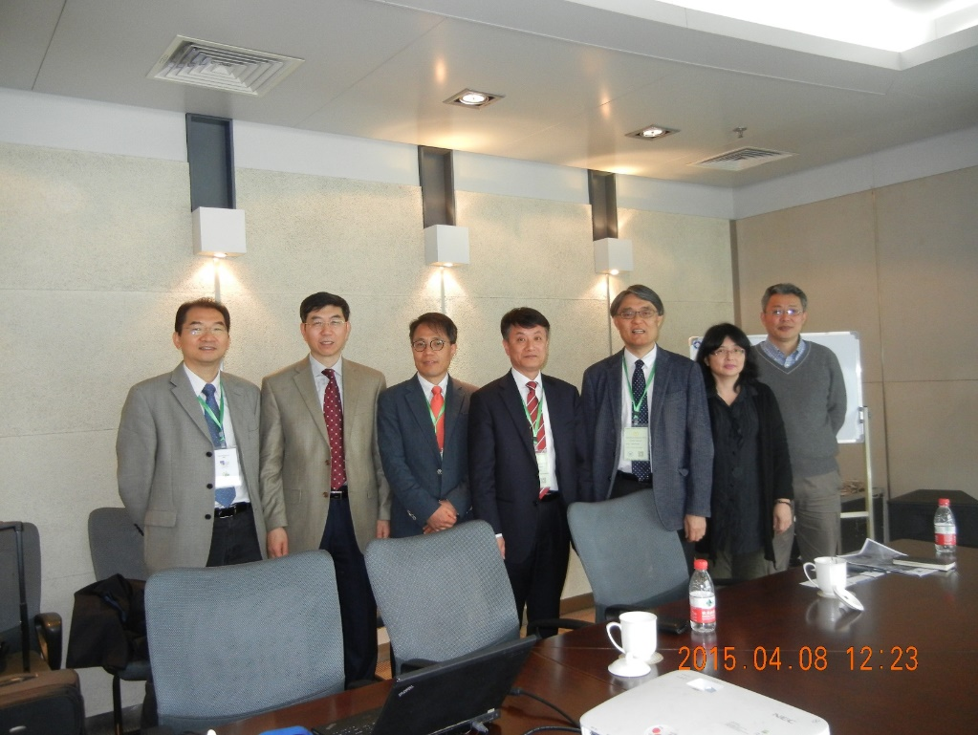
Activities of NBB Division in 2015
The first NBB division board meeting was held in Hangzhou on April 8, 2015, during the China Nanomedicine 2015 Conference. Co-chaired by Professor Xian-En Zhang and Professor Tai Hyun Park
From left to right: Mengsu (Micheal) Yang, Xian-En Zhang, Man Bock Gu, Tai Hyun Park, Eiichi Tamiya, Mei Jywan Syu, and Ning Gu.

Slide 4
NBB division cosponsored the 2nd International Conference on Nanomedicine and Nanobiotechnology (China Nanomedicine 2015), which was held on April 6-9 in Hangzhou, China (www.nanomedicine.cn). Co-chaired by Professor Xian-En Zhang
The First Asian Symposium of Nanobiotechnology was held in Nagoya, during Japan Society of Applied Physics 2015. The symposium was organized by Eiichi Tamiya. Three NBB members (Ning Gu, Man Bock Gu and Xian-En Zhang) attended the events.
NBB division organized AFOB-EFB Joint Symposium on NBB, which was held in Kuala Lumpur on November 18, 2015, during ACB 2015.

Slide 5
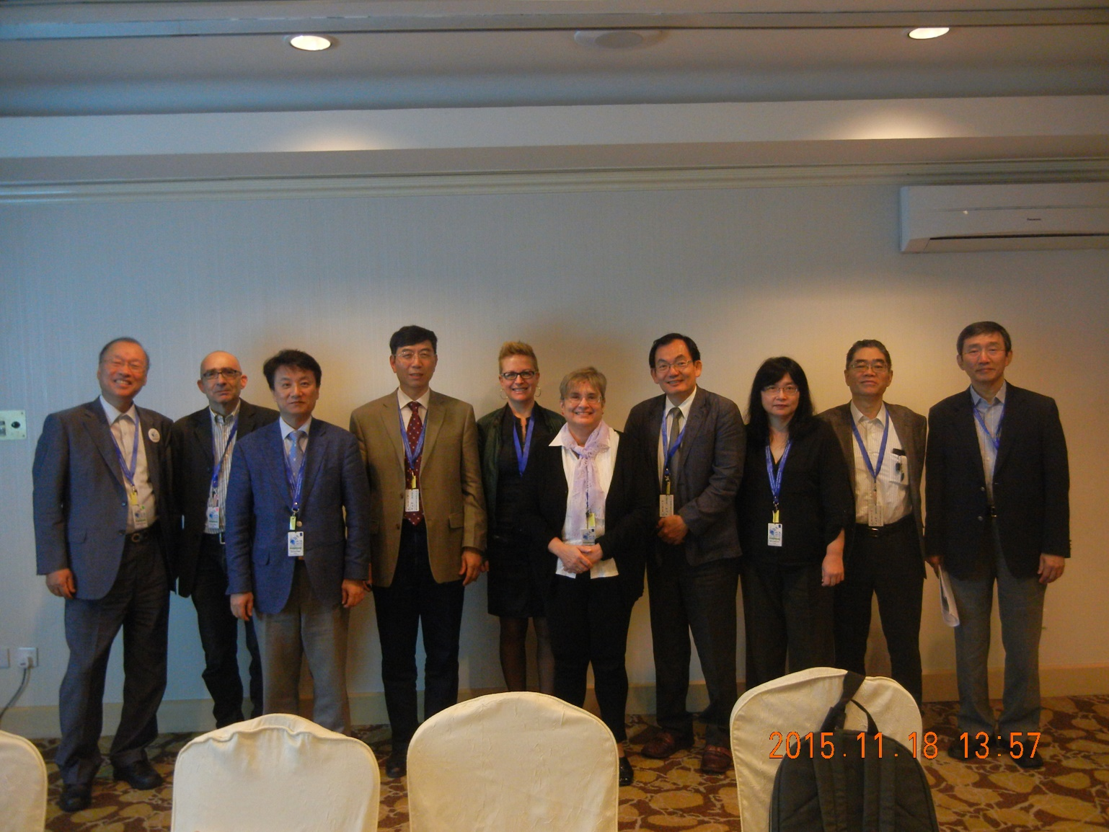
NBB division board meeting was held on November 18, 2015, during ACB 2015 in Kuala Lumpur

Slide 6
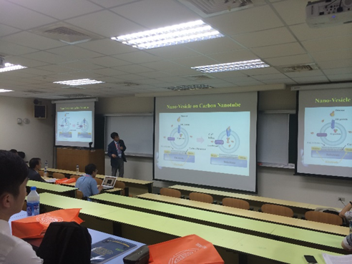
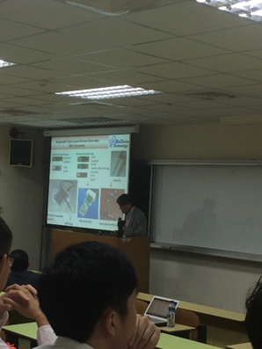
Activities of NBB Division in 2016
NBB Symposium at KSBB(The Korean Society for Biotechnology and Bioengineering) Spring meeting. Date: April 21, 2016; Gyeongju, Korea, Chairs：Prof. Tai Hyun Park and Prof Man Bock Gu
NBB Symposium at BEST meeting. June 25, 2016; National Central Univ, Taoyuan, Taiwan, Chair: Professor Wen-Yih Chen

Slide 7
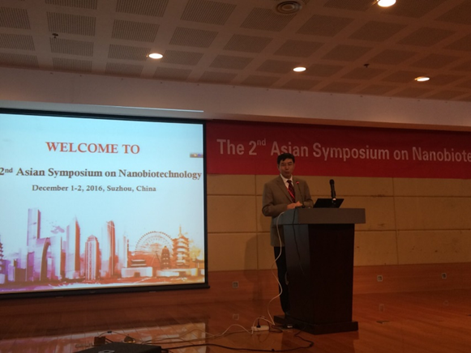
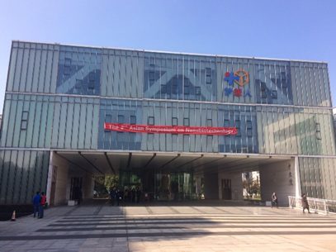
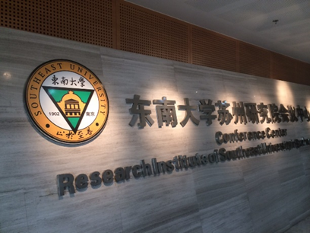
AFOB session on Convergence Biotechnoogy at IBS 2016 (www.ibs2016.org). Organized by Professor Tai Hyun Park, Date: October 25, 2016. Venue: Melbourne Convention Centre, Melbourne, Australia
The Second Asian Symposium on NanoBiotechnology, organized by NBB, Suzhou China, October, 2016
Co-chairs: Professor Ning Gu and Professor Xian-En Zhang

Slide 8
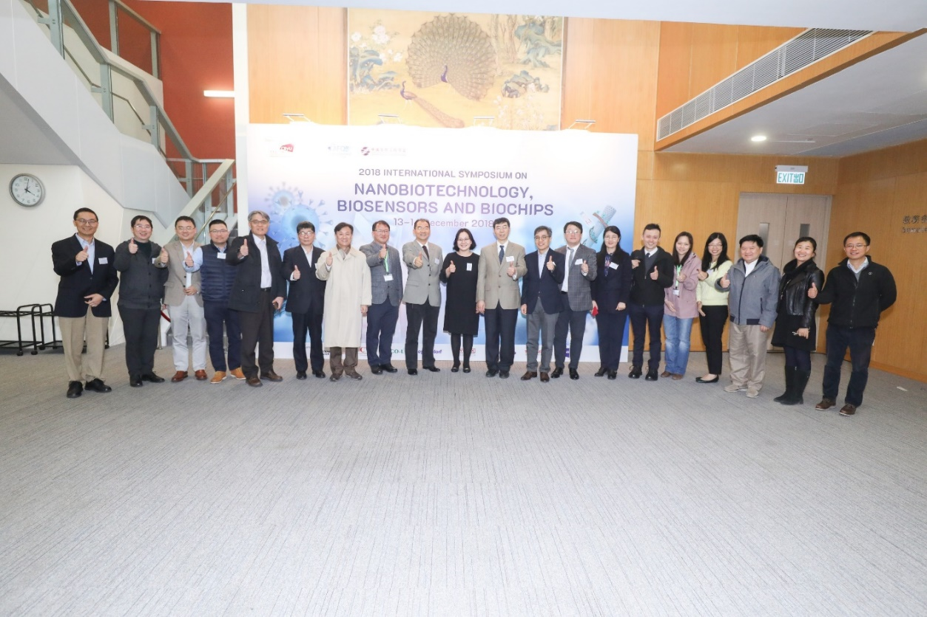
Activities of NBB Division in 2018
EFB-AFOB Joint Session on Nanobiotechnology, Geneva, Switzerland, July 4, 2018. Organizers: Tai Hyun Park and Christophe Moreau
International Symposium on Nanobiotechnology, Biosensors and Biochips, Hong Kong, December 14, 2018. Professor Michael Yang Chaired the symposium and the NBB cochairs Professors Tai Hyun Park and Xian-En Zhang and other NBB division members attended the symposium.

Slide 9
Activities of NBB Division in 2019
BBN/NBB China Forum, Jinan, China, May 25, 2019. The forum is organized by BBN Division of Chinese Society of Biotechnology. Professor Xian-En Zhang is the founder and chair of the Forum. The NBB is cosponsor.
AFOB-EFB Joint Symposium on Nanobiotechnology, Tamsui, Taiwan, July 3, 2019. Organized by Tai Hyun Park and Christophe Moreau

